Slide 1
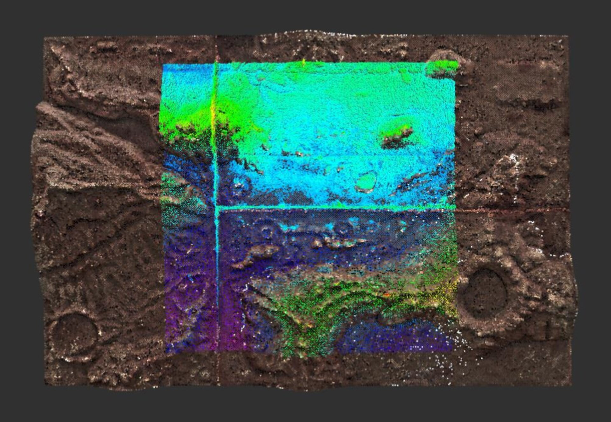
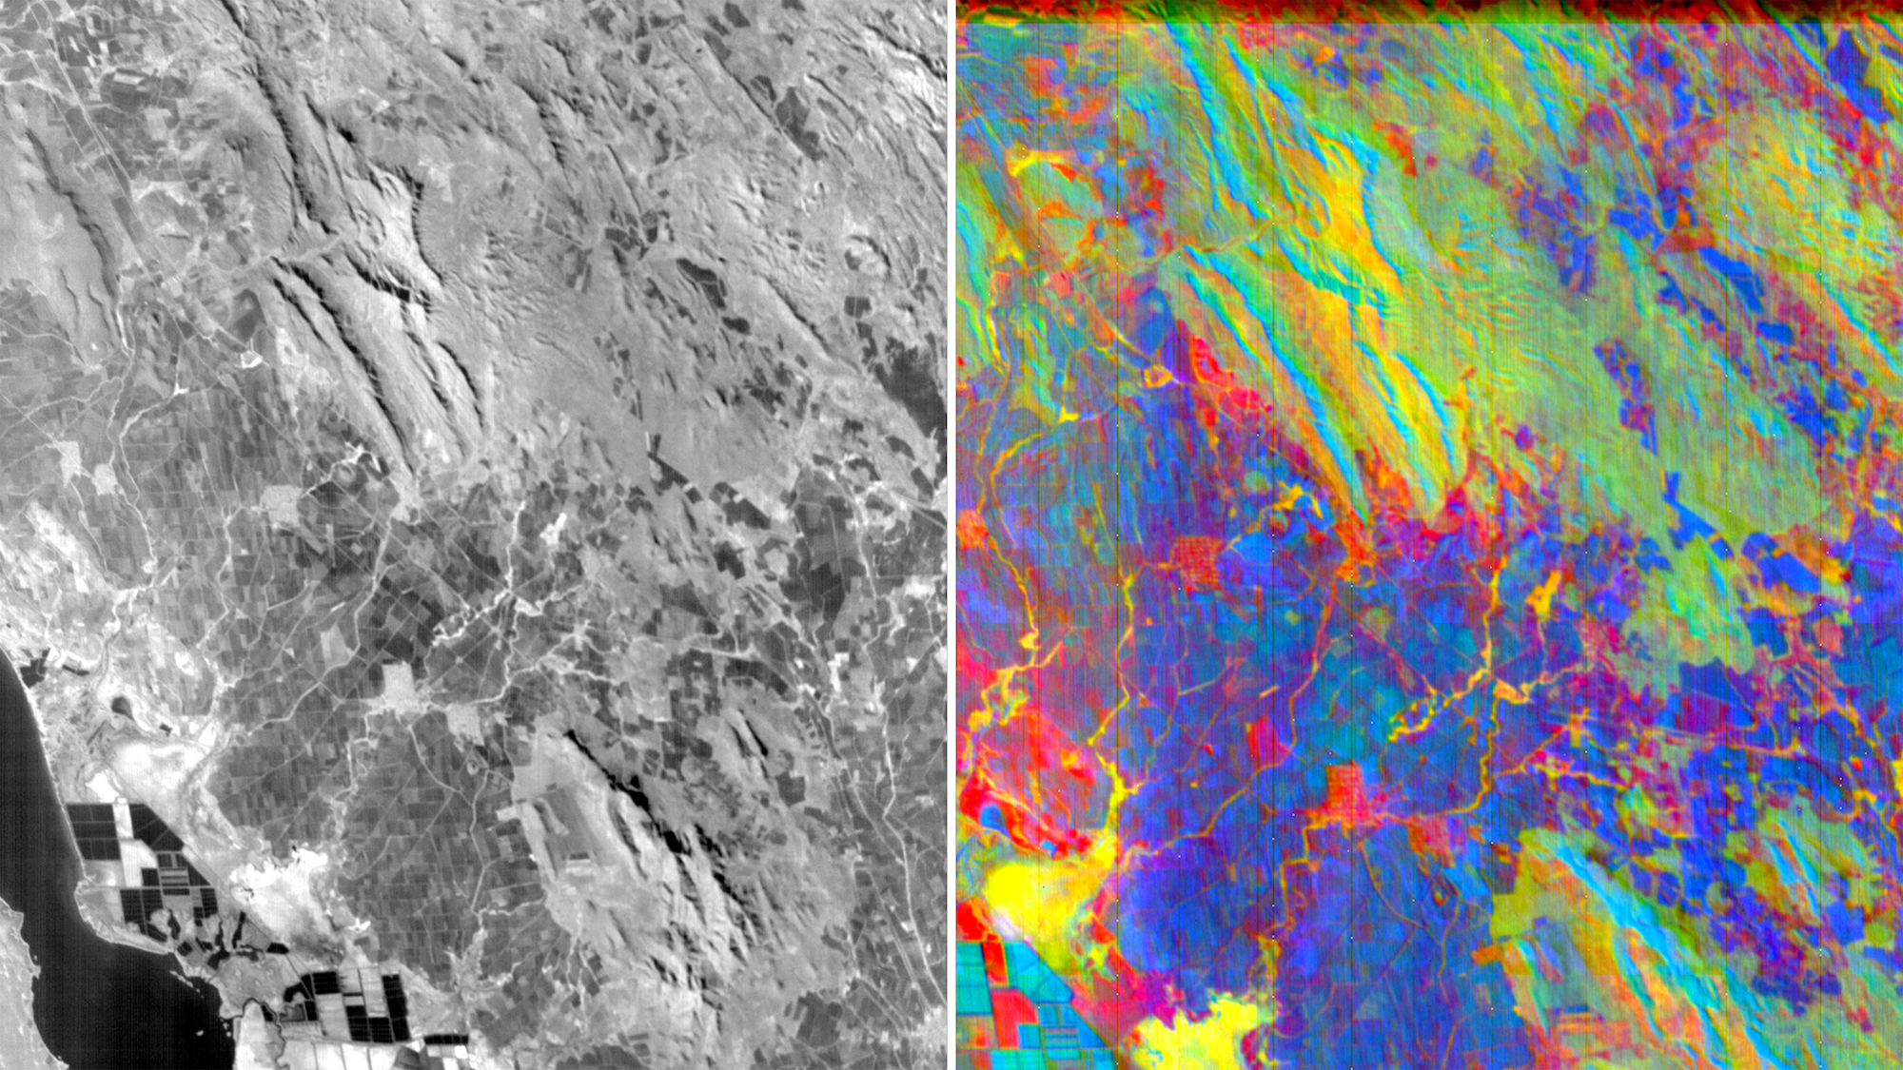
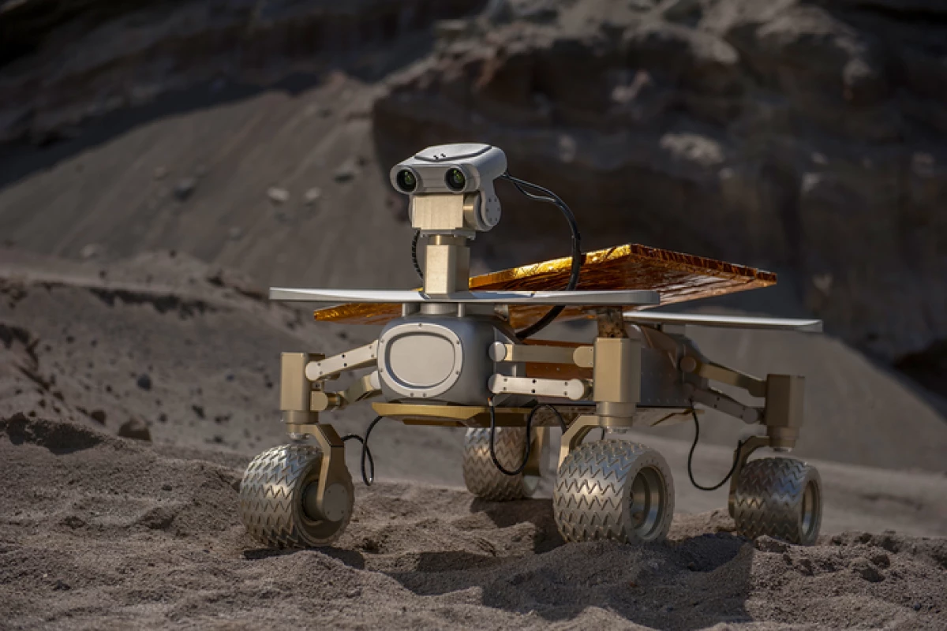
Autonomous Lunar Exploration
Intelligent Rover Navigation & Regolith Resource Extraction
Zhengming Ding (CS) & Zizhan Zheng (CS) Cynthia J. Ebinger (EES)
Why Autonomous Lunar Rovers?
Sustained lunar presence requires reliable autonomous systems
Rovers enable mobility, science, and ISRU (regolith mining)
Challenge:
Moon's unstructured, heterogeneous, and dynamically changing landscapes
Rovers must operate with high autonomy due to communication delays & limited bandwidth
Earth-in-the-loop oversight is impractical for time-critical tasks
Objective 1
(Terrain Scene Perception)
Obstacle/ slope detection
Traversability map
Objective 2
(Multi-Sensory Mineral Recognition)
Mineral class & location
Confidence
Conduct Scientific Research
Train Students
Collaborate with NASA
Secure External Grants
Objective 3
(Robust Rover Control)
Trajectory Generation
Motion Control
Adaptive/Robust Controllers

Slide 2
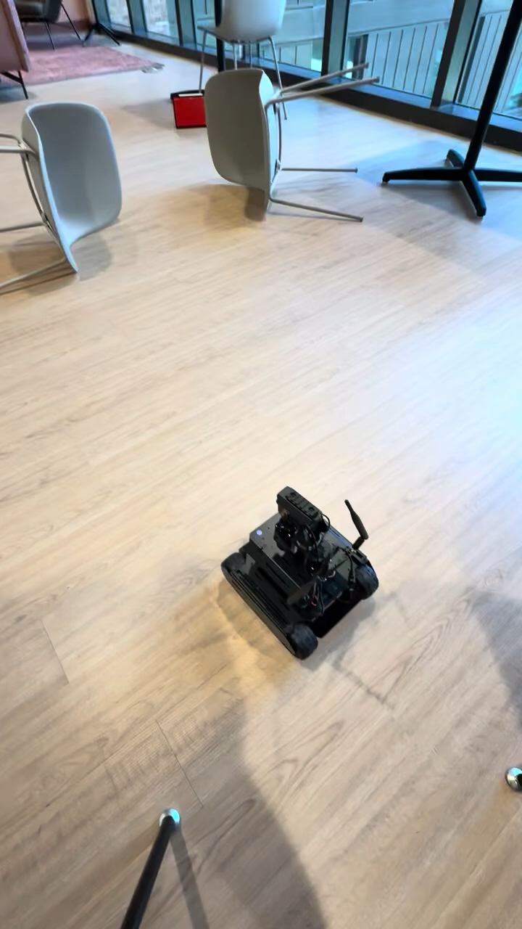

Hardware Device:
Waveshare UGV Rover ROS 2 Open-Source 6-Wheels 4WD AI Robot
Research Progress and Plan
Student Supervision and Research Activities:
Capstone Project (2025–2026): Developed a camera-based autonomous rover navigation system.
REU Students (Summer 2026): Conducted space robotics research and presented results at a poster session.
Graduate Student (Summer 2026): Conducted research on Vision-Language-Action (VLA).
Capstone Project (2026–2027): Ongoing on Camera & Depth rover perception, and navigation.
External Grants Received:
BoR/EPSCoR Seed Grant from LASpace: $40,000 to support the development of AI-enabled autonomous systems for space-related applications.
New Space-related Connections:
Juan M. Lorenzo (LSU) — collaboration in planetary/lunar science and exploration.
NASA Marshall Space Flight Center — Dr. Michael Zanetti — connection focused on lunar exploration, rover technologies, and potential NASA-related research opportunities.
Cislune — Erik Franks — connection with the commercial lunar exploration sector and potential opportunities for AI-enabled lunar robotics.
Deepen NASA Collaboration & Strengthen Louisiana Space Partnerships

